Slide 1


Indiana Soccer Referees Association Web Application
Team 17
Aishwarya Consul | Jack Folz
Namrata Mahesh | Joseph Theodore

Slide 2
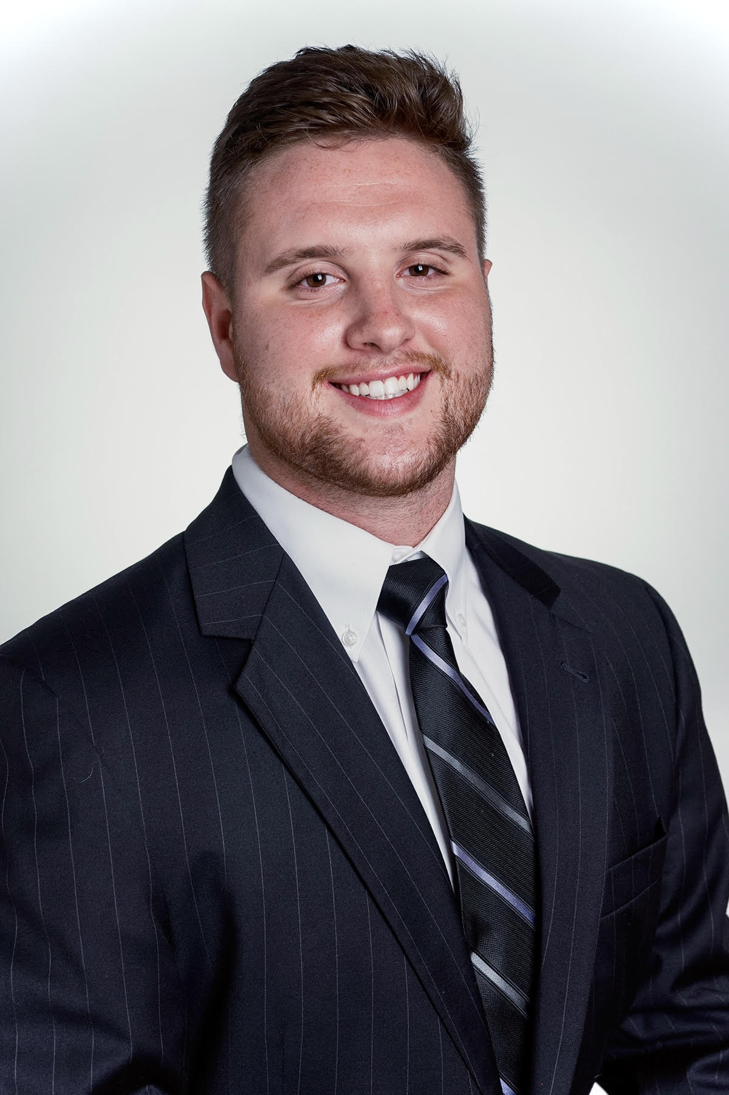
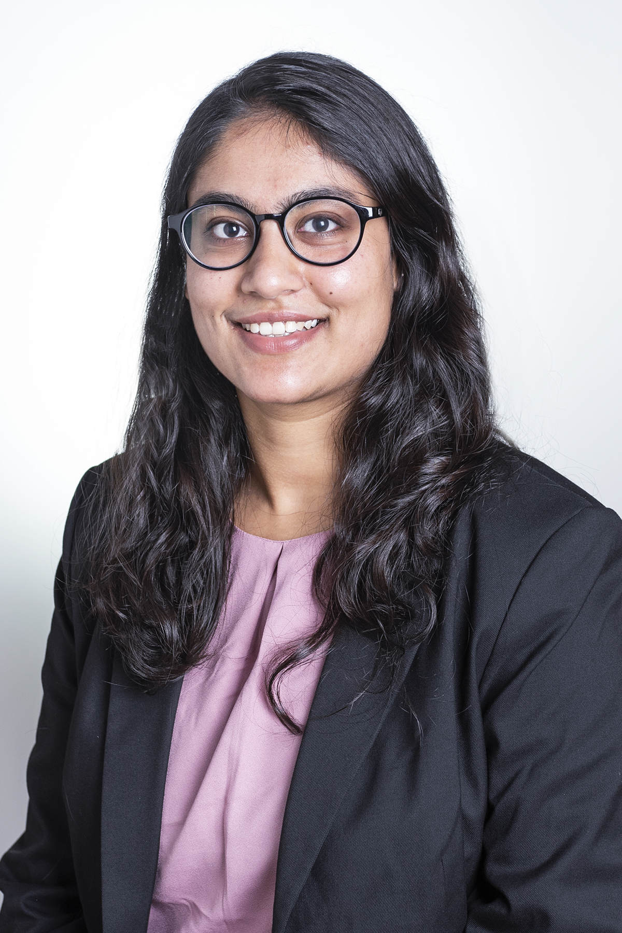
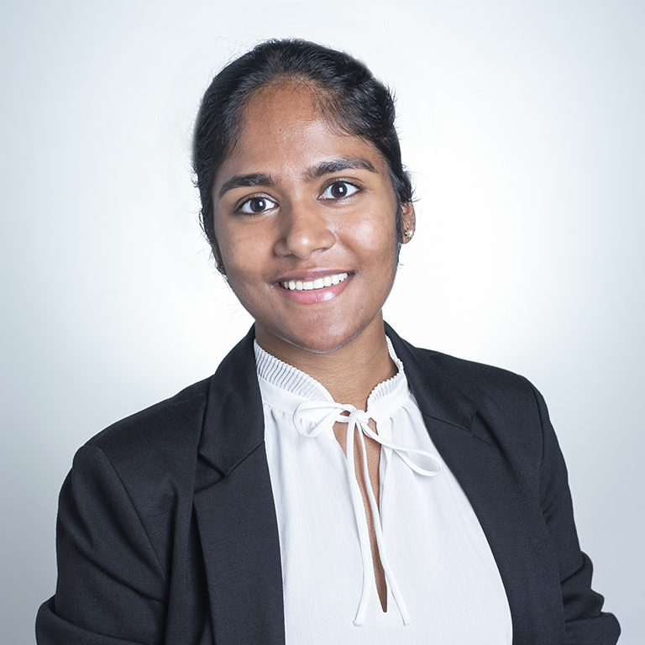

Team Introduction
Jack Folz
Senior
Web Developer
Aishwarya Consul
Associate
Web Developer
Namrata Mahesh
Associate
Web Developer
Joe Theodore
Associate
Web Developer

Slide 3
Agenda/Contents
Value Proposition
The Problem
Business Outcomes
Scope, Time, and Resources
Version 2 Vision
Application Demo
Working Application
Business Case
Problem Solving Approach
Technology Stack Justification
Key Takeaways and Lessons Learned
Team Organization
Design Process
What We Learned in the Process
Work Breakdown
SQL Breakdown
HTML and Bootstrap
VueJS, PHP, Amazon EC2 Instance

Slide 4

Value Proposition

Slide 5
Problem We Are Trying to Solve
The ISRA is struggling to keep with assigning referees to games around the state and managing and tracking statuses is becoming overwhelming using Microsoft Excel.
We were tasked with creating a custom web application to assign referees to games around Indiana and manage the specific credentials of referees.
We were given a list of requirements and features that were requested by the client, and we have incorporated those in the application

Slide 6
Business Outcomes
Upon completion of the application, we would like to have an interface where Theas Signor can, with only a few clicks, see all the available referees and their respective assignments as well as assign referees to unassigned games.
This will save Theas a lot of time and productivity and they can better focus their efforts toward improving other areas of the Indiana Soccer Referee Association.
Cloud deployment will make it much easier to manage and scale out if they decide to open the application up to similar organizations in the state.

Slide 7
Scope, Time, and Resources
Scope | Time | Resources
Relational, cloud hosted database to store referee, game, and assignment data with add, edit, and update permissions. Various view screens to show important information regarding referees and games. Reports that can be downloaded as CSV files for easy distribution. | Project Start: September 27th, 2021 Project Finish: November 8th, 2021 | 1 Senior Web Developer: Jack Folz Market Rate: $85/hour 3 Associate Web Developers: Aishwarya Consul Namrata Mahesh Joseph Theodore Market Rate: $50/hour

Slide 8
Version 2 Vision
Upon approval to move into the next development stage, we are envisioning an application where not only Theas can access the systems, but referees, coaches and players are able to access the web portal and find information about their games
Referees can request swaps on games, coaches can see information about their opponents and field conditions and players can get information about location, weather, and other information about their games.
A comprehensive Indiana Soccer application.
Scope | Time | Resources
Added functionality for different stakeholders. Login/Roles with Embedded Security Permissions More APIs that can access other external applications. Custom Ad-Hoc Reports | 15-18 weeks | Additional advanced developers at market rate of $85/hour

Slide 9

Application Demo

Slide 10

Final Deliverable
Click Here to View the Application!

Slide 11

Business Case
This application is going to make your lives easier by having an updated view of referee assignments for the state of Indiana and an efficient way to access the information needed to assign an official to a game.

Slide 12
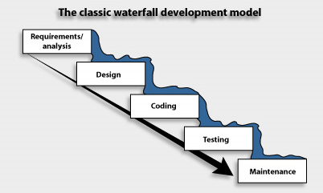
Problem Solving Approach
After considering different methodologies to software/application development, we decided the best approach to this problem was to incorporate a Waterfall approach to the ISRA application
With limited contact/feedback review meetings with you, we thought that utilizing a heavy agile approach to create iterations would not be beneficial.
As we move into future versions of the app, we can transition into more of an agile approach where we can meet with you after iterative sprints for maximum efficiency.

Slide 13
Technology Stack Justification
Cloud Hosted Application
Offers enhanced capabilities in terms of security and scalability.
Amazon EC2 Instance
Reduces server reboot time.
Compatible with other AWS services for future versions.
GitHub
After passing application to ISRA, future versions can be scaled and collaborative within ISRA tech teams.

Slide 14

Key Takeaways and Lessons Learned

Slide 15
Team Organization
Our team decided to be as collaborative as possible with respect to the project. This meant updating each other on what work was being done by each member so that everyone was in the loop.
This structure allowed us to learn from each other and give suggestions or connect members with peers who had solutions for certain errors.
We made sure to update each other especially, when we ran into errors so that we could share the frustrations with our team instead of feeling discouraged or inadept.

Slide 16
Design Process
We had started with ER diagrams and paper prototypes of what our application was going to look like.
We then worked on creating SQL tables and adding dummy data to the 3 tables.
The next step was deciding on the HTML template and wireframing the index.html page.
We then moved on to wireframing our referees.html and games.html pages.
Our Vue JS logic was being built to enable the application logic. We started off with simple code to ensure that we got the basics right for one page.
We then created our server and hosted our database on AWS.
The next step was to implement PHP/JSON APIs and get VueJS to consume them. Once we had one app working, we quickly replicated to other apps.
As we mastered the basic functionality, we tackled the trickier parts such as the ability to edit/delete existing records.
Moreover, we started finalizing on the look of the application to make it as user-friendly as possible and host it on EC2.

Slide 17
What We Learned in the Process
We need to have a plan of action before jumping into the coding aspect of the application. As such, we had to deliberate about what functionality the application will provide, what it will look like to users and what are the required logical entities.
We were tempted to increase the scope of the project to have more functionalities initially but pushed each other to commit to what we could realistically deliver.
We learned that not everyone has to be good at every area. There are certain strengths that each of us have. Translating that to this project was a bit difficult as after the planning process we had to jump into coding. We decided to divide the responsibilities by what each member felt comfortable with. Jack's prior experience allowed for quick troubleshooting when one of us ran into errors.
It is key to focus on functionality first before the design in this situation. Since the code allows the app to perform the required tasks, focusing on this area first gave us time to troubleshoot if things were not working.
We did set up cutoff times for when we needed help. We developed a chain of assistance: Classmates>> GA >> Professor. This helped us learn more when figuring out what other groups did before approaching the GA or Professor. For one, this was way quicker. However, this also allowed us to see what improvements could be made in our way of working with the code when asking other people.
We started getting comfortable with encountering errors and knowing that even relatively simple tasks will take a lot of time. Thus, our planning always had a lot of buffer time built into it as we knew errors were inevitable.

Slide 18

Work Breakdown

Slide 19
SQL Breakdown (Aishwarya and Namrata)
We used our homework assignment as a reference point to start off with
Initially we created the basic SQL schema like creating a database, adding the required tables
We tried figuring out the appropriate data types such as date/time and enum type
Learning: Trying to look up the documentation in order to run the right queries was a bit tricky initially. However, knowing this was the starting point for the team to test out the application made us finish it faster
We created the dummy data to load the tables with
We then started creating the necessary relationships to ensure that the database was working alright.
We initially ran into troubles creating a composite key
We got feedback and then removed the composite key by having a unique assignment ID
Learning: We were able to look at overall table relationships in order to know we were on the right track. We learnt that it was important to keep things simple in the initial version before building up the functionalities.

Slide 20
HTML and Bootstrap (Joe)
Finalized wireframes with group and researched basic HTML tags and elements.
Designed index HTML page first and then the individual HTML pages.
Received information from Namrata and Aishwarya regarding the different tables, fields, etc from the SQL scheme they developed.
Incorporated a bootstrap template for consistence across the navigation bar and overall look and feel of the webpage.
Helped Jack connect each page to each other and ensure basic functionality of navigation bar and tables
Throughout this process, I learned a lot in terms of technical capabilities and team dynamics of web/application development. I learned how to effectively use the internet for various code and techniques to incorporate into our own webpages rather than building things from scratch myself. I learned the importance of gaining feedback in a development team as I frequently went back to my team with updates on the HTML layout and they provided me with some great insights as to what we could do better to improve the overall look of the website. After finishing up the skeleton HTML pages, I was reenforced on the way APIs are generated using VueJS with Jack.

Slide 21
VueJS, PHP, Amazon EC2 Instance (Jack)
Connected VueJS to each page so that I could begin building API connections.
With these connections, I was able to link the different methods created to the different php APIs.
This was crucial to the success of our project because without VueJS and PHP we would not be able to see the data that we created or the different functionalities within our site.
After the project had been completed, I created an Amazon EC2 instances. This allowed us to have a live link that is always running through the cloud.

Slide 22
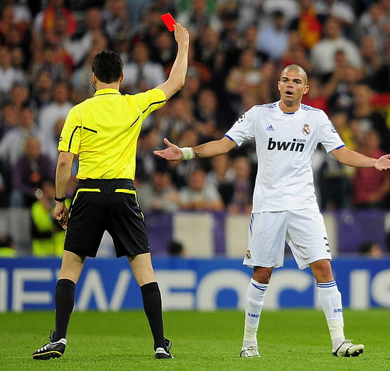
Appendices

Slide 23
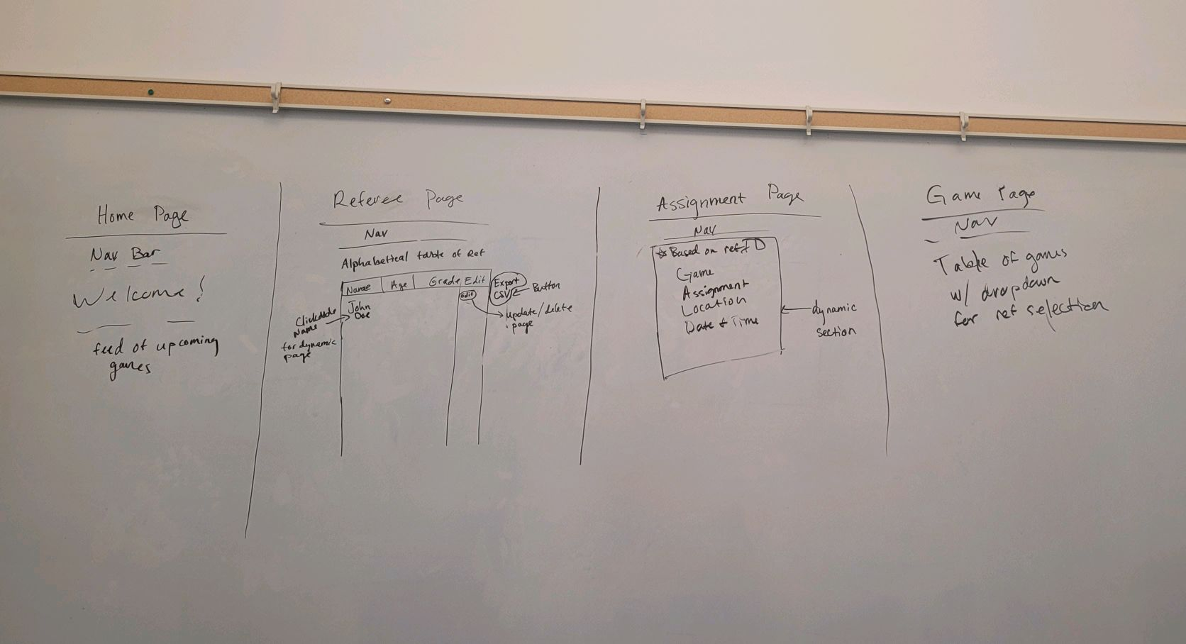
Design Documents
Pictures of our initial design process/high level wire frames

Slide 24
User Stories – Version 1
As an assignor, I want to view a list of referees and their basic information such as name, age, referee grade and rating so that I can edit or update them, if needed.
As an assignor, I want to create a new referee record so that I can add new referee details.
As an assignor, I want to delete a referee record so that I don’t have information that I don’t need.
As an assignor, I want to view a list of games and their basic information such as location, date, and time so that I can edit or update them, if needed.
As an assignor, I want to create a game record so that I can track and manage assignments.
As an assignor, I want to delete a game record so that I don’t have information that I don’t need.
As an assignor, I want to view a list of assignments and their basic information such as status, referee, game so that I can edit or update them, if needed.
As an assignor, I want to add an assignment so that I can associate a referee with a position in a game.
As an assignor, I want to delete an assignment record so that I don’t have information that I don’t need.
As an assignor, I want to download referee, game, and assignment reports so that I can work on them offline or share them.

Slide 25
User Stories – Version 2
As an assignor, I want to view selected referee’s details so that I know all games assigned to a referee, in the future and past.
As an assignor, I want to view selected game’s details so that I know all associated assignments.
As an assignor, I want a report that lists all games assigned to a referee in a given date range so that I can manage them in case of unforeseen situations like emergency absence, leaves, etc.
As an assignor, I want a report that lists all future games with at least one position of status “Unassigned” so that I can prioritize them.
As a coach, I want to be able to log in and see the location and time of my game so that I can properly notify my players
As a referee, I want to be able to create custom ad-hoc reports based on my assignments and other criteria so that I can effectively get an understanding of my weekly games.
As a player, I want to be able to log into the portal and view the weather conditions for my game so that I can dress and prepare accordingly.

Slide 26
Risks and Mitigation
The user does not buy-in to the idea
AWS Disruption
Corrupted configuration files
Severity
​ | ​ | ​
​ | ​ | ​
​ | ​ | ​
Severity
​ | ​ | ​
​ | ​ | ​
​ | ​ | ​
Severity
​ | ​ | ​
​ | ​ | ​
​ | ​ | ​
Likelihood
Likelihood
Likelihood
The user does not find the application intuitive. As such, we will try to switch our approach from Waterfall to a more Agile method in order to be on the same page as the client.
The application is hosted on AWS and will not work in the event of a disruption. This could be hosted on a second cloud provider as well as backup like Azure.
The application might not work if the configuration files are corrupted. As such, it would be vital to have a backup of these files for quick replacement.

Slide 27
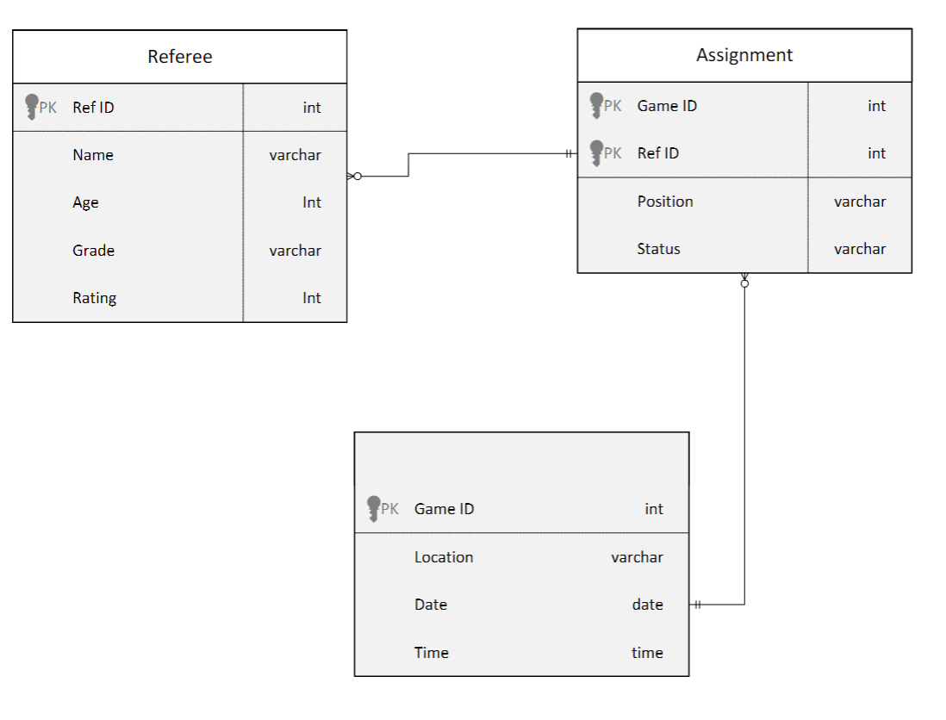
Data Model

